Slide 1
Chapter 12
Media Access Control(MAC)

Slide 2
Chapter 12: Outline
12.1 RANDOM ACCESS
12.2 CONTROLLED ACCESS
12.3 CHANNELIZATION

Slide 3
Chapter 12: Objective
The first section discusses random-access protocols. Four protocols, ALOHA, CSMA, CSMA/CD, and CSMA/CA, are described in this section. These protocols are mostly used in LANs and WANs, which we discuss in future chapters.
The second section discusses controlled-access protocols. Three protocols, reservation, polling, and token-passing, are described in this section. Some of these protocol are used in LANs, but others have some historical value.
The third section discusses channelization protocols. Three protocols, FDMA, TDMA, and CDMA are described in this section. These protocols are used in cellular telephony, which we discuss in Chapter 16.

Slide 4
Chapter 12: Outline
12.1 RANDOM ACCESS
12.2 CONTROLLED ACCESS
12.3 CHANNELIZATION

Slide 5
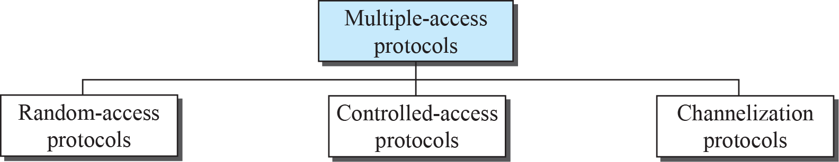
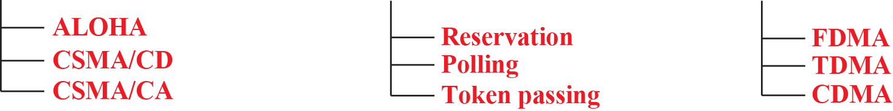
12장: Media Access Control(MAC)
Multiple Access
  When nodes and stations are use a common link, called multi-point or broadcast link, we need multiple-access protocol to coordinate access to shared link.

Slide 6
12.1 Random Access
Random Access (or Contention)
  No station is superior to another station and none is assigned control over another.
  A station that has data to send uses a procedure to make a decision on whether or not to send.
  This decision depends on the state of the medium (idle or busy).

Slide 7
12.1.1 ALOHA
ALOHA, the earliest random access method, was developed at the University of Hawaii in early 1970.
It was designed for a radio (wireless) LAN, but it can be used on any shared medium.
  The medium is shared between the stations.
When a station sends data, another station may attempt to do so at the same time.
  The data from the two stations collide and become garbled.

Slide 8
12.1.1 ALOHA
Pure ALOHA
  Each station sends a frame whenever it has a frame to send (multiple access).
    When a station receives a frame. It sends an acknowledgement.
    If the acknowledgement does not arrive after a time-out period, the station resends the frame.
  Some of frames will collide because multiple stations are in contention to the only one shared channel.

Slide 9
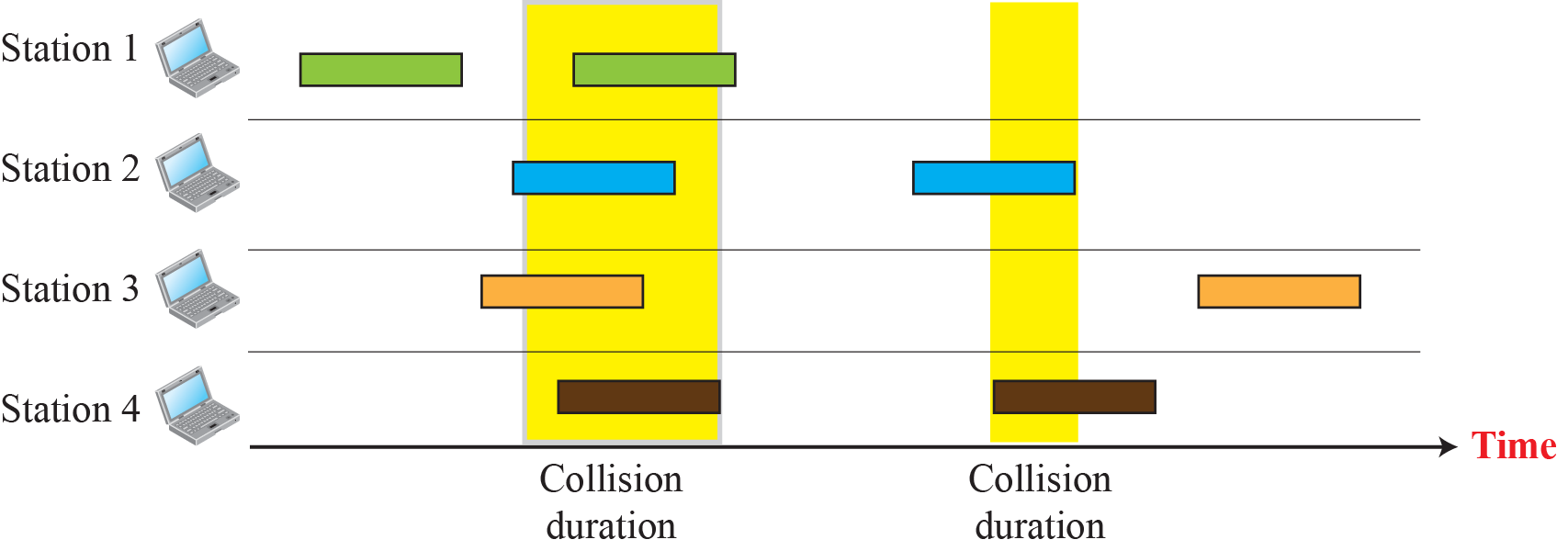
12.1.1 ALOHA
Frames in Pure ALOHA Network
  Since there is only one channel to share, there is possibility of collision.

Slide 10
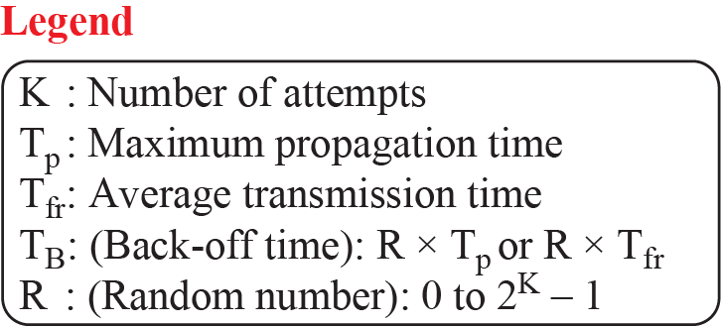
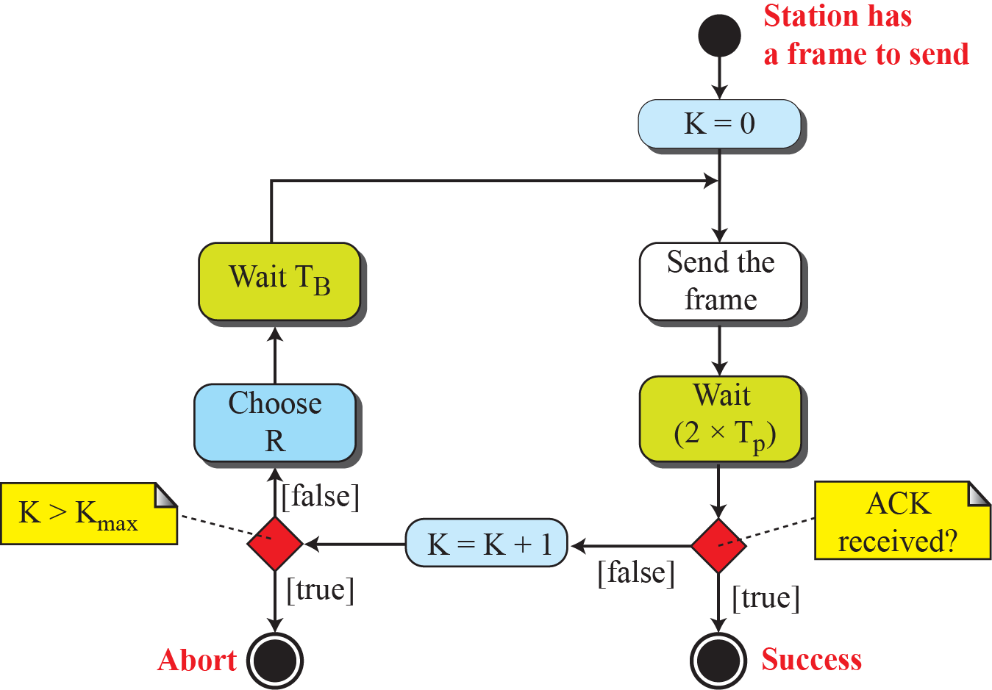
12.1.1 ALOHA
Procedure for Pure ALOHA Protocol

Slide 11
12.1.1 ALOHA
예제 12.1:
  The stations on a wireless ALOHA network are a maximum of 600 km apart.
  If we assume that signals propagate at 3×10⁸ m/s, we find T_{p} = (600×10³) / (3×10⁸) = 2ms.
  For K = 2, the range of R is {0, 1, 2, 3}.
  Since T_{B} = T_{p} x R, the back-off T_{B} can be 0, 2, 4 or 6ms based on the random variable R.

Slide 12
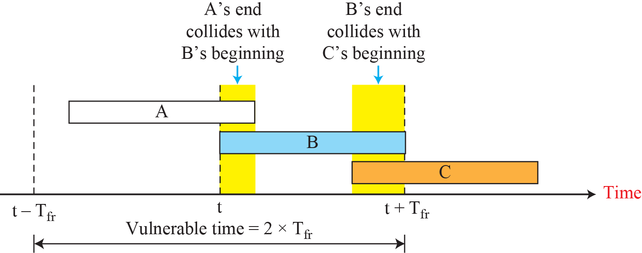
12.1.1 ALOHA
Vulnerable time for pure ALOHA protocol

Slide 13
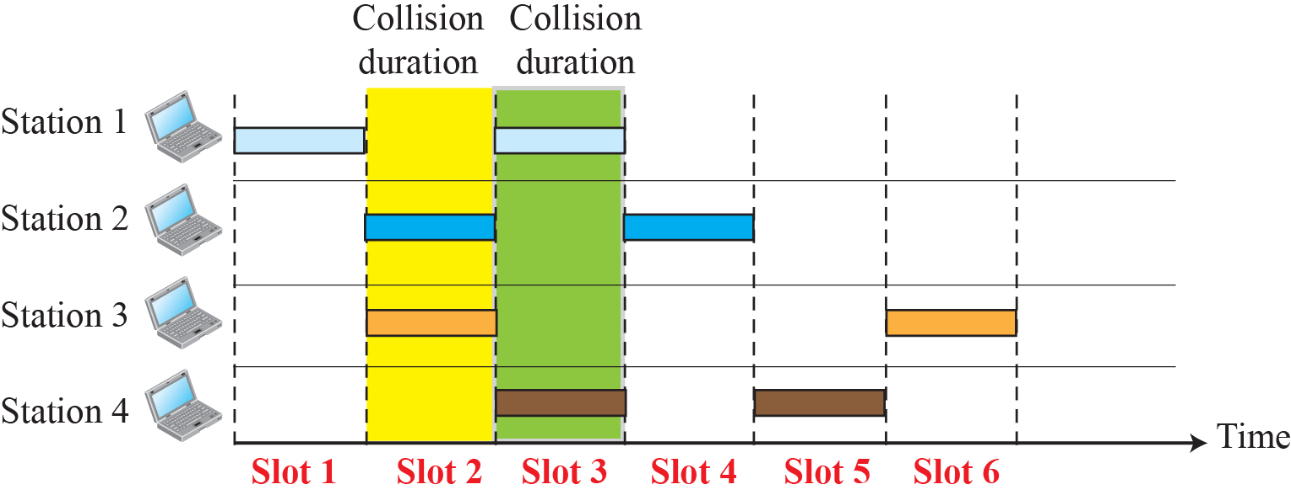
12.1.1 ALOHA
Slotted ALOHA
  Time is divided into slots of T_{fr} seconds.
  A station can send only at the beginning of the time slot.
  If two station begin the transmission at the same time, the collision is occurred.
Frames in a Slotted ALOHA Network

Slide 14
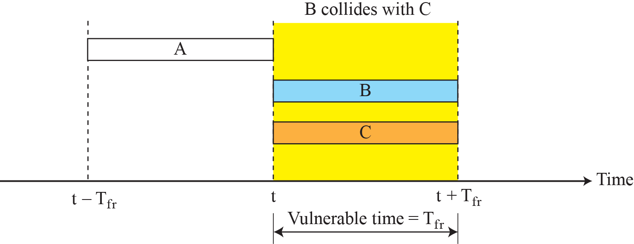
12.1.1 ALOHA
Vulnerable Time for Slotted ALOHA Protocol
  There is still collision, if two station try to send at the same time slot.
  The vulnerable time is reduced to one-half, equal to T_{fr}.

Slide 15
12.1.2 CSMA
Carrier Sense Multiple Access(CSMA)
  To minimize the chance of collision and increase the performance, the CSMA method was developed.
    The chance of collision can be reduced if a station senses the medium before trying to use it.
  Carrier sense multiple access (CSMA) requires that each station first listen to the medium (or check the state of the medium) before sending.
    In other words, CSMA is based on the principle “sense before transmit” or “listen before talk.”

Slide 16
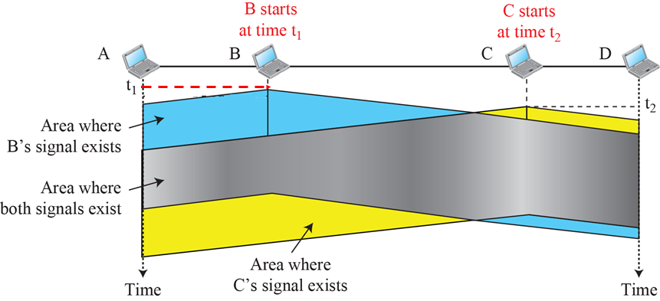
12.1.2 CSMA
Space/Time Model of a Collision in CSMA

Slide 17
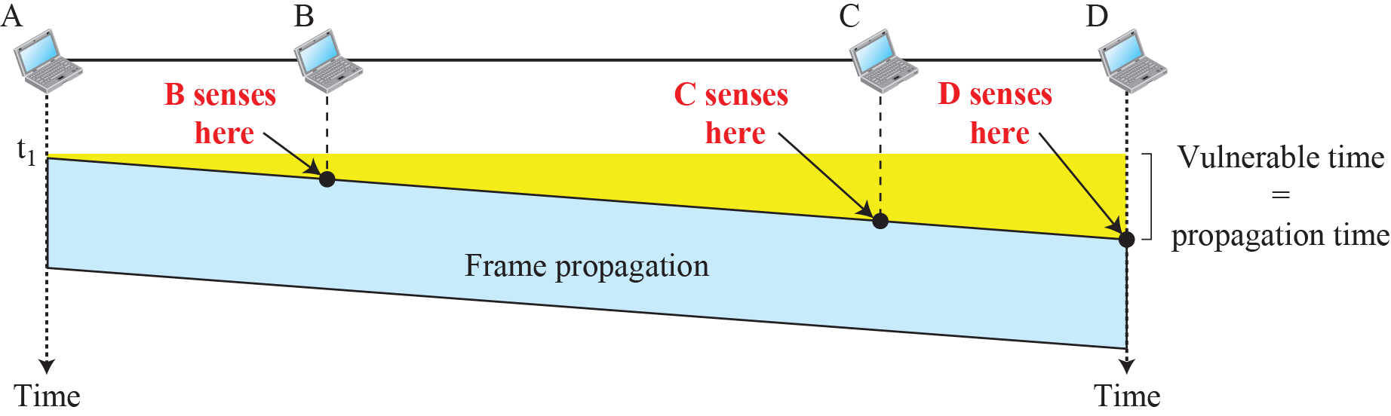
12.1.2 CSMA
Vulnerable Time in CSMA

Slide 18
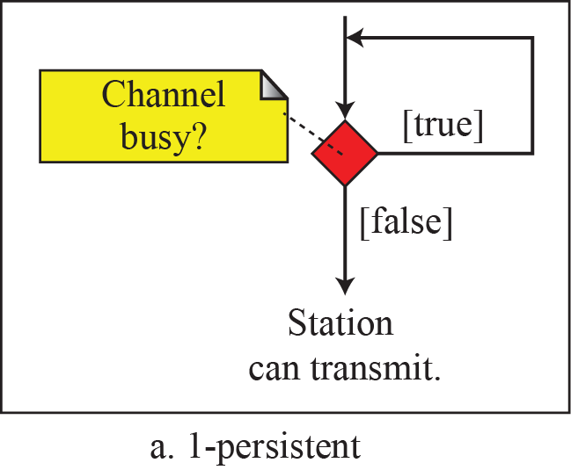
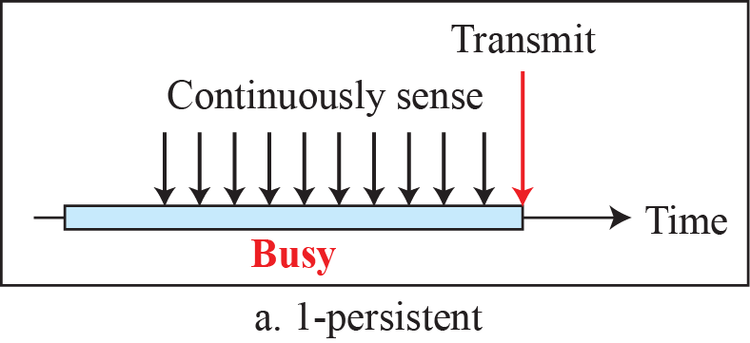
12.1.2 CSMA
Three Persistent Method
  1-persistent method
    A node senses the transmission medium for idle or busy.
    If idle, then it transmits immediately. (probability=1).
    If busy, then it senses the medium continuously.

Slide 19
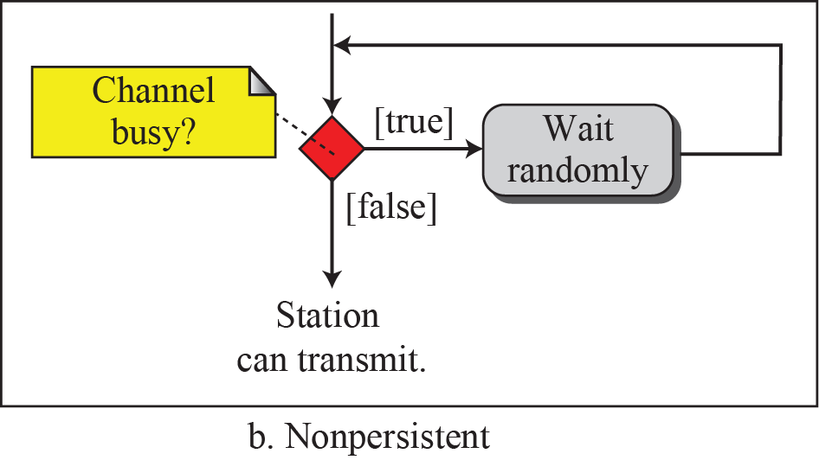
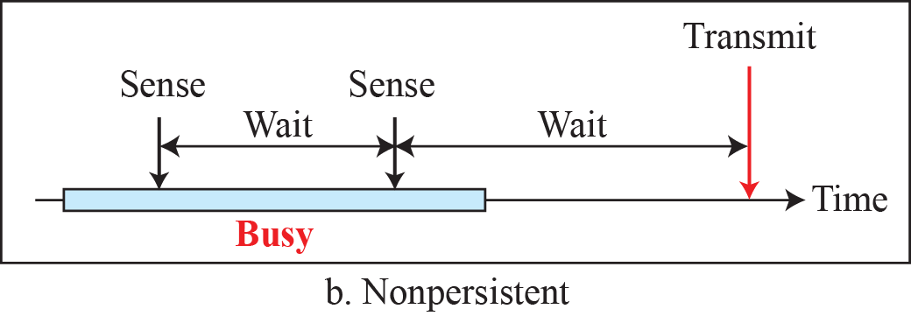
12.1.2 CSMA
Three Persistent Method
  b. Non-persistent method
    A node senses the transmission medium for idle or busy.
    If idle, then it transmits immediately.
    If busy, then it waits for a random period of time

Slide 20
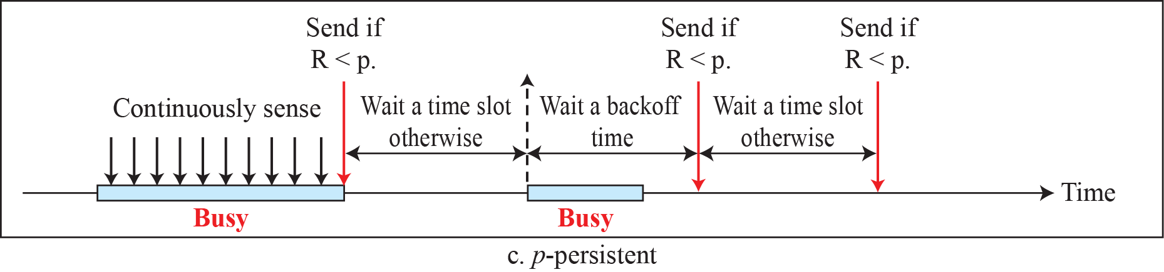
12.1.2 CSMA
Three Persistent Method
  c. p-persistent method
    A node senses the transmission medium for idle or busy.
    If busy, it senses the medium continuously until it becomes idle, then transmits with probability p.
    If the node has the probability of 1-p, it waits until the next available time slot.
    If the medium is not busy, it transmits again with the same probability p.

Slide 21
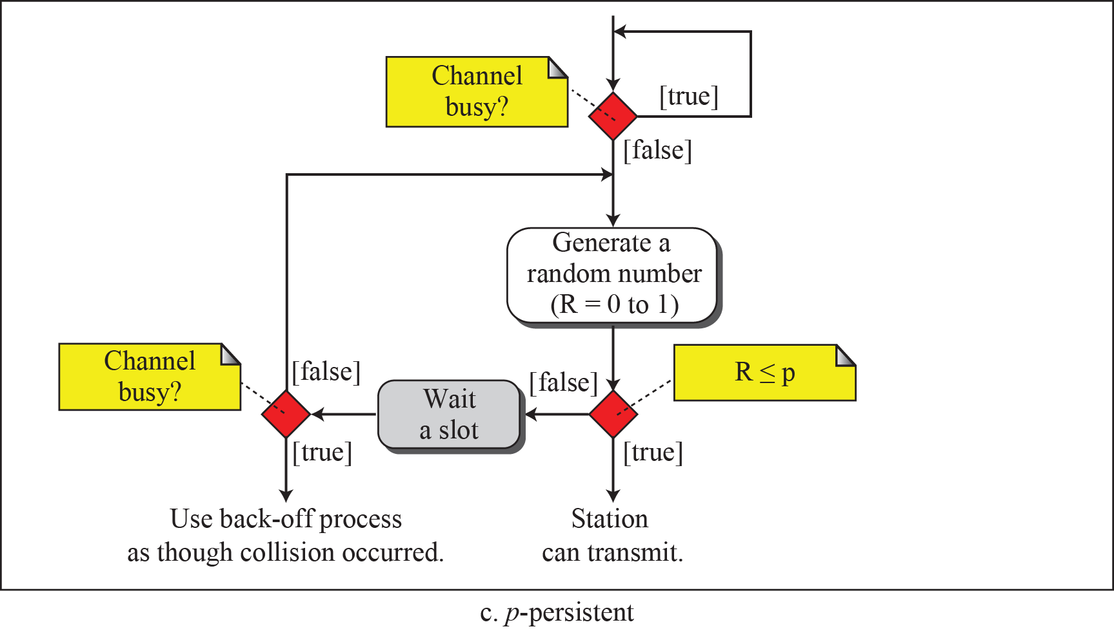
12.1.2 CSMA
Three Persistent Method
  c. p-persistent method

Slide 22
12.1.3 CSMA/CD
Carrier Sense Multiple Access with Collision Detection(CSMA/CD)
  CSMA/CD augments the algorithm to handle the collision.
  A station monitors the medium after it sends a frame to see if the transmission was successful.
  If so, the station is finished. If, however, there is a collision, the frame is sent again.

Slide 23
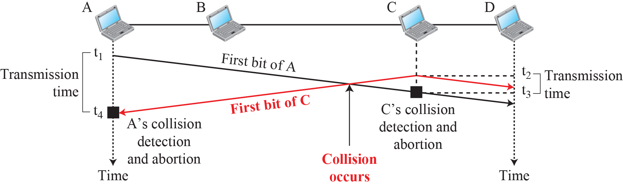
12.1.3 CSMA/CD
Collision of the First Bits in CSMA/CD

Slide 24
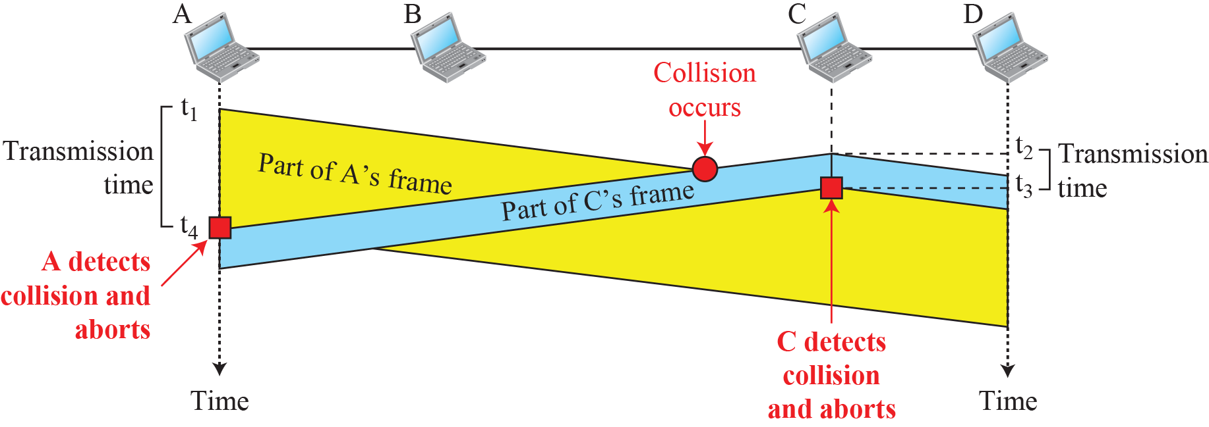
12.1.3 CSMA/CD
Collision and abortion in CSMA/CD
Minimum Frame Size
  For CSMA/CD to work, the frame size must be restricted.
  The frame transmission T_{fr} must be two times the maximum propagation time T_{p} .
T_{p}
T_{fr}

Slide 25
12.1.3 CSMA/CD
A CSMA/CD network has a bandwidth of 10Mbps.
If the maximum propagation time T_{p} is 25.6μs.
  (including the delays in the devices and ignoring the time of sending a jamming signal, as we see later)
What is the minimum size of the frame?
Solution
  The minimum frame transmission time is T_{fr} = 2×T_{p} = 51.2μs.
    This means, a station needs to transmit for a period of 51.2μs to detect the collision.
  The minimum size of the frame is 10Mbps×51.2μs = 512bits or 64 bytes.
    This is actually the minimum size of the frame for Standard Ethernet.

Slide 26
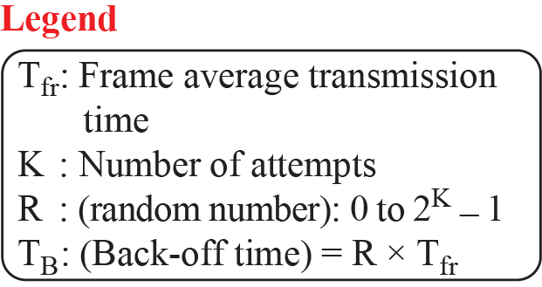
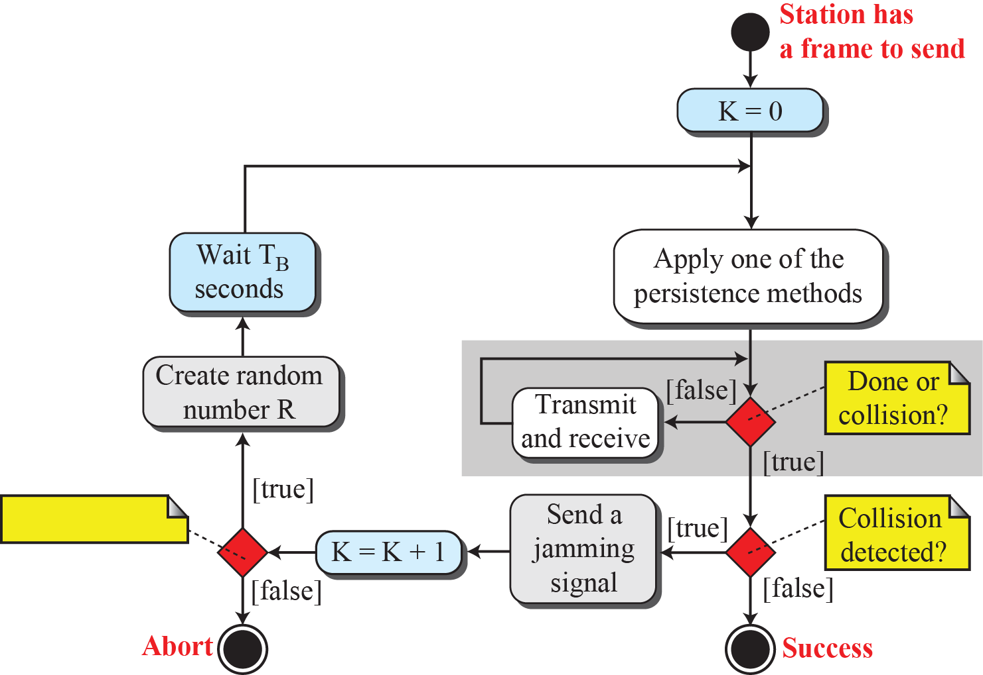
12.1.3 CSMA/CD
Flow diagram for the CSMA/CD
두 번째 충돌을 줄이기 위해 Backoff에서 대기함
K < 15 ?

Slide 27
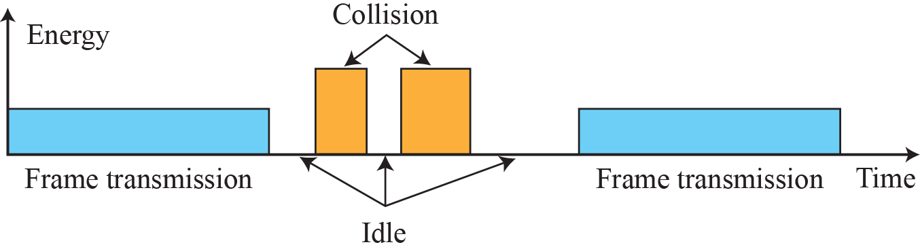
12.1.3 CSMA/CD
Traditional Ethernet
  10Mbps, Manchester Encoding
  1-persistent CSMA/CD method
Energy level during transmission, idleness, or collision
  At zero level, channel is idle.
  At normal level, a station is sending a frame(+v or –v).
  At abnormal level, the level is twice with collision.

Slide 28
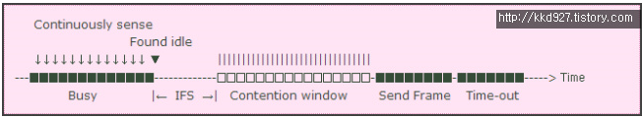
12.1.4 CSMA/CA
Carrier Sense Multiple Access with Collision Avoidance(CSMA/CA)
  CSMA/CA was invented for wireless networks.
  Collisions are avoided through the use of CSMA/CA’s three strategies:
    InterFrame Space (IFS)
    Contention Window
    Acknowledgments

Slide 29
12.1.4 CSMA/CA
Inter-frame Space(IFS) : Access Defer
  If the medium is continuously idle for IFS duration, it is then permitted to transmit a frame.
    Even though the channel is idle, a distant station may have started transmitting.
  Several IFS in 802.11
    DIFS(DCF IFS) : A station must wait for DIFS duration to send RTS(Request to Send) control frame.
    SIFS(Short IFS) : A station must wait for SIFS duration to send Data, CTS(Clear to Send), or ACK frame.
  DCF(Distributed Coordination Function) :
    DCF specifies random backoff, which forces a station to defer its access to the channel for an extra period.
    The length of the backoff period is determined by the following equation:
Standard | Slot time (µs) | DIFS (µs)
IEEE 802.11n(2.4 GHz) | 9 or 20 | 28 or 50
IEEE 802.11n(5 GHz) | 9 | 34

Slide 30
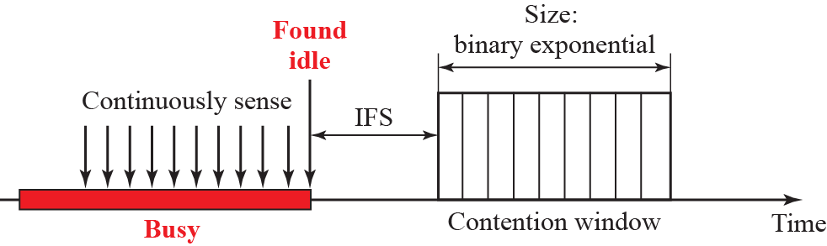
12.1.4 CSMA/CA
Contention Window
  Contention Window is an amount of time divided into slots.
  A station which is ready to send chooses a random number of slots as its waiting time.
  Binary exponential backoff strategy
    If the station cannot detect an idle channel after IFS time, it set double waiting time.

Slide 31
12.1.4 CSMA/CA
Acknowledgement
  The positive acknowledgement must be sent to guarantee the safe receiving of the frame.
  After the data is transmitted and the SIFS is passed, the receiver send the ACK.
NAV(Network Allocation Vector)
  Collision avoidance mechanism
  NAV is a timer for a station that how long it must defer from accessing the medium.
    When a station sends an RTS frame, it includes the time that it needs to occupy the channel in Duration field .
  Each time a station accesses the wireless system and sends an RTS frame, other stations start their NAV.

Slide 32
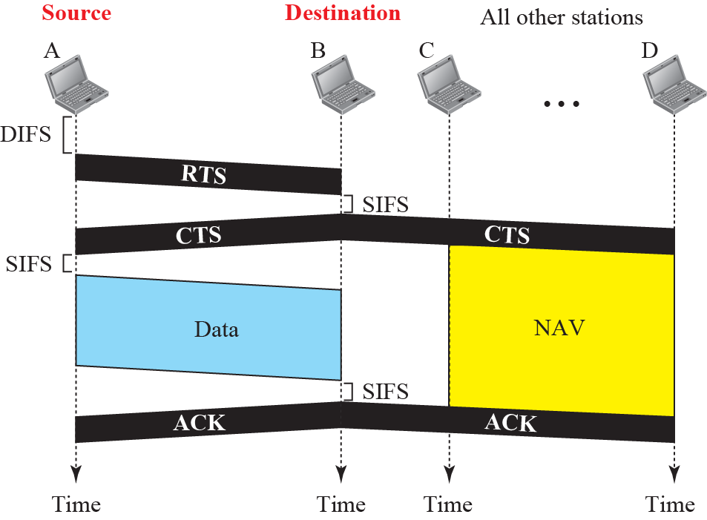
12.1.4 CSMA/CA
CSMA/CA and NAV
(Request to Send)
(Clear to Send)
(Network Allocation
Vection)

Slide 33
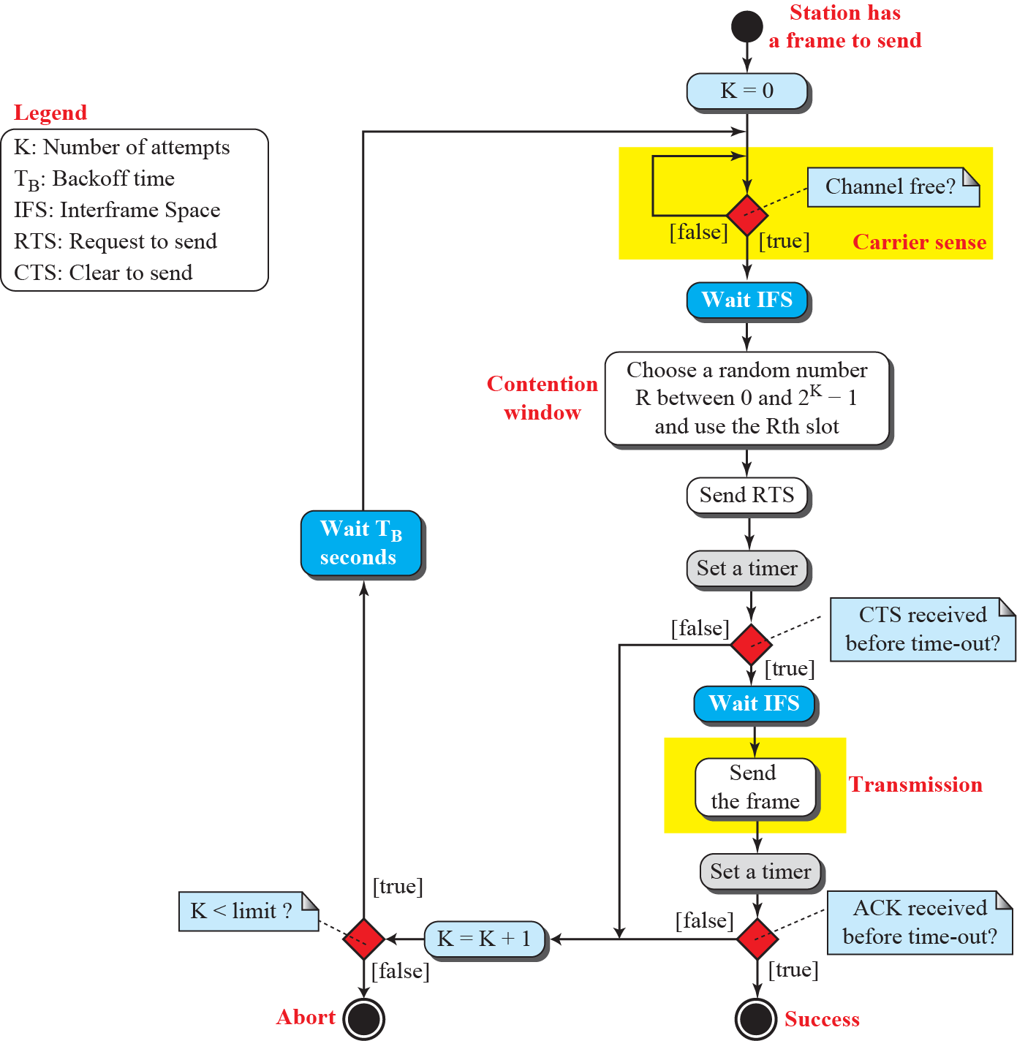
12.1.4 CSMA/CA
Flow Chart of CSMA/CA

Slide 34
12.2 Controlled Access
Controlled Access
  The stations consult one another to find which station has the right to send.
  A station cannot send unless it has been authorized by other stations.
3 Controlled Access Mechanism
  Reservation
  Polling
  Token passing

Slide 35
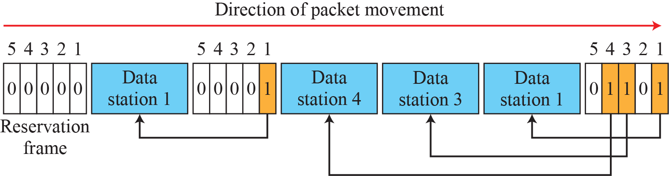
12.2.1 Reservation
Reservation
  A station needs to make a reservation before sending data.
  Time is divided into intervals.
  In each interval, a reservation frame precedes the data frames sent in that interval.

Slide 36
12.2.2 Polling
Polling
  Polling works with topologies in which one device is designated as a primary station and the other devices are secondary stations.
    The primary controls the link.
    The secondary follow its instructions.
  Two Functions
    Select Functions
    Poll Functions

Slide 37


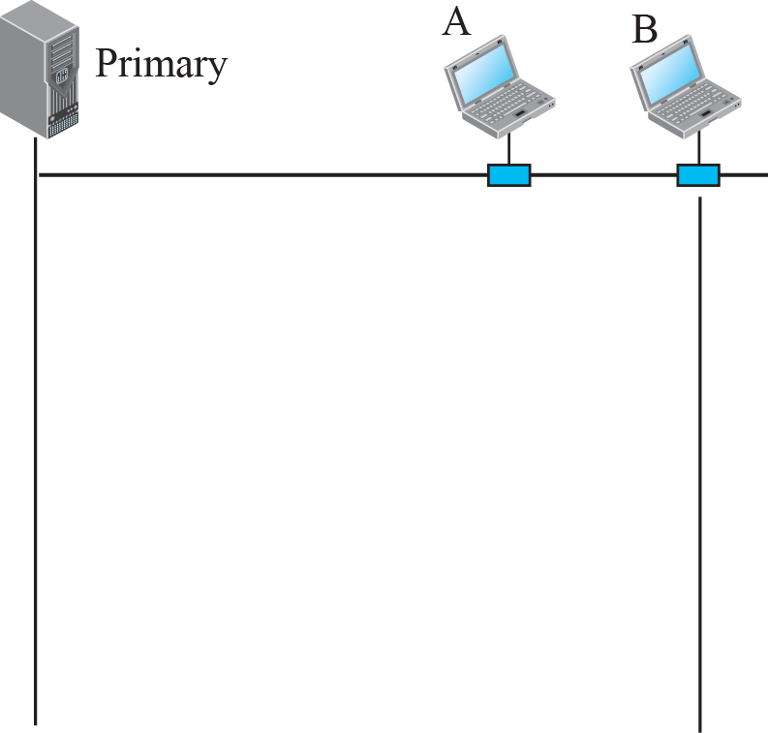
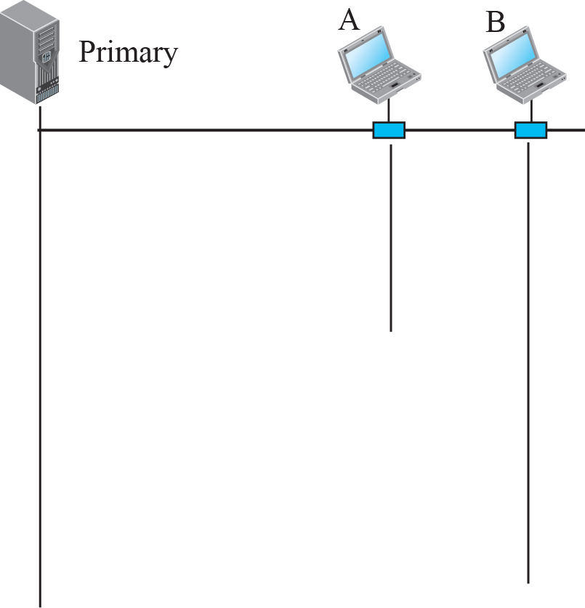





12.2.2 Polling
Select and Poll Functions in Polling Method
Primary transmits select(SEL) frame with secondary address
Primary has something to send Data.
Primary ask(poll) to secondary nodes in turn if they has anything to send.
Secondary response NAK or Data.

Slide 38
12.2.3 Token Passing
Token Passing
  The stations in a network are organized in a logical ring.
  For each station, there is a predecessor and a successor.
    The predecessor is logically before the station in the ring;
    The successor is logically after the station in the ring.
  A special packet called token circulates through the ring.
    The possession of the token gives the station the right to access the channel.

Slide 39
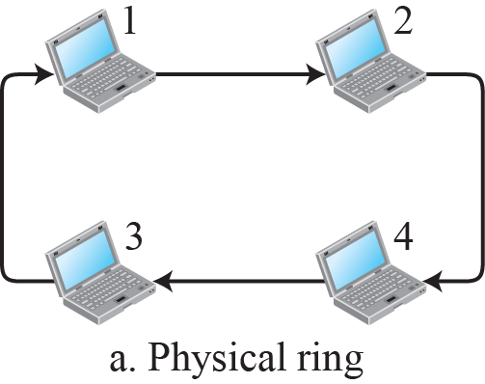
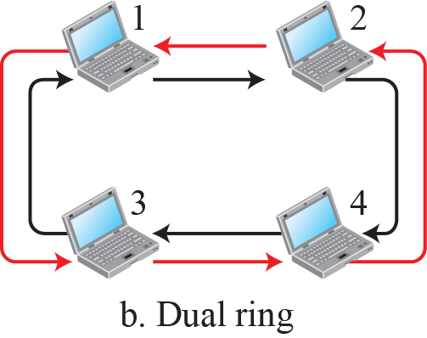
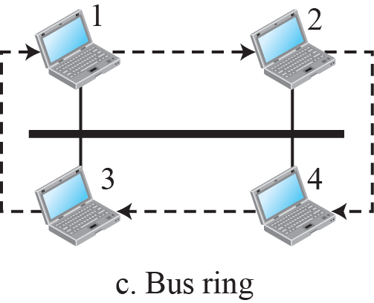
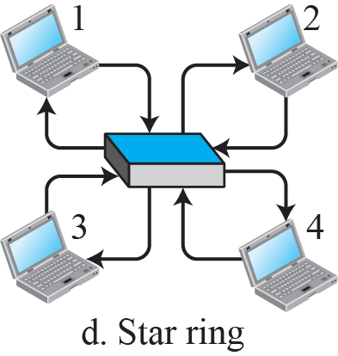
12.2.3 Token Passing
Logical and Physical Ring in Token Passing Method
Token Bus

Slide 40
12.2.3 Channelization
Channelization(Channel Partition)
  Channelization is a multiple-access method in which the available bandwidth of a link is shared in time, frequency, or through code, among different stations.
Channelization Protocol
  Frequency Division Multiple Access (FDMA)
  Time Division Multiple Access (TDMA)
  Code Division Multiple Access (CDMA)

Slide 41
12.3.1 FDMA
Frequency Division Multiple Access (FDMA)
  The available bandwidth is divided into frequency bands.
  Each band is reserved for a specific station, and it belongs to the station all the time.
  Each station also uses a bandpass filter to confine the transmitter frequencies.

Slide 42
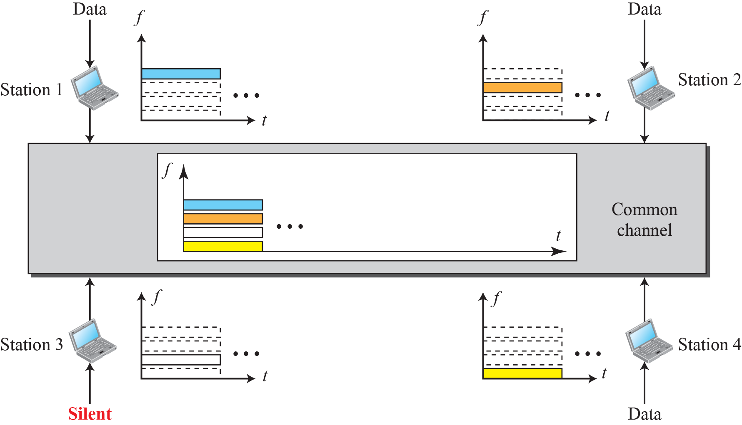
12.3.1 FDMA
Frequency-Division Multiple Access (FDMA)

Slide 43
12.3.2 TDMA
Time Division Multiple Access (TDMA)
  The stations share the bandwidth of the channel in time.
  Each station is allocated a time slot during which it can send data.
  Each station transmits its data in its assigned time slot.

Slide 44
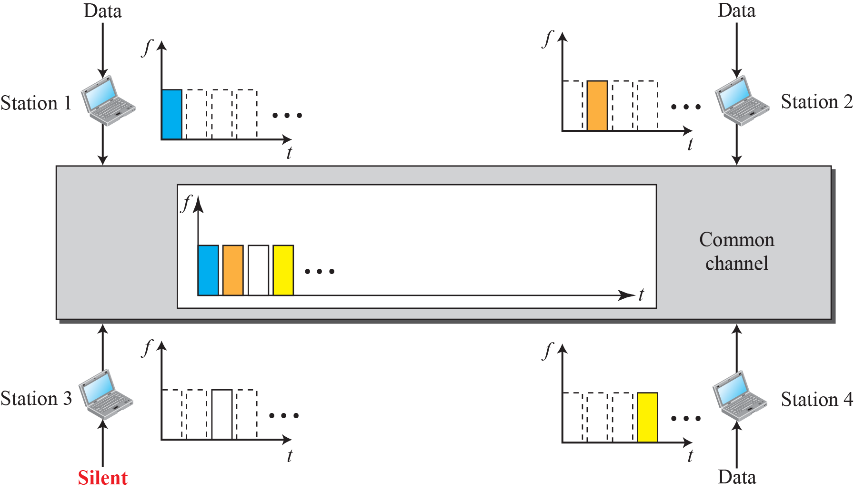
12.3.2 TDMA
Time Division Multiple Access (TDMA)

Slide 45
12.3.3 CDMA
Code Division Multiple Access (CDMA)
  CDMA differs from FDMA in that only one channel occupies the entire bandwidth of the link.
  It differs from TDMA in that all stations can send data simultaneously; there is no timesharing.

Slide 46
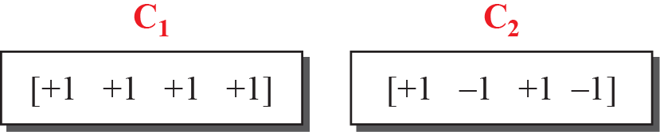
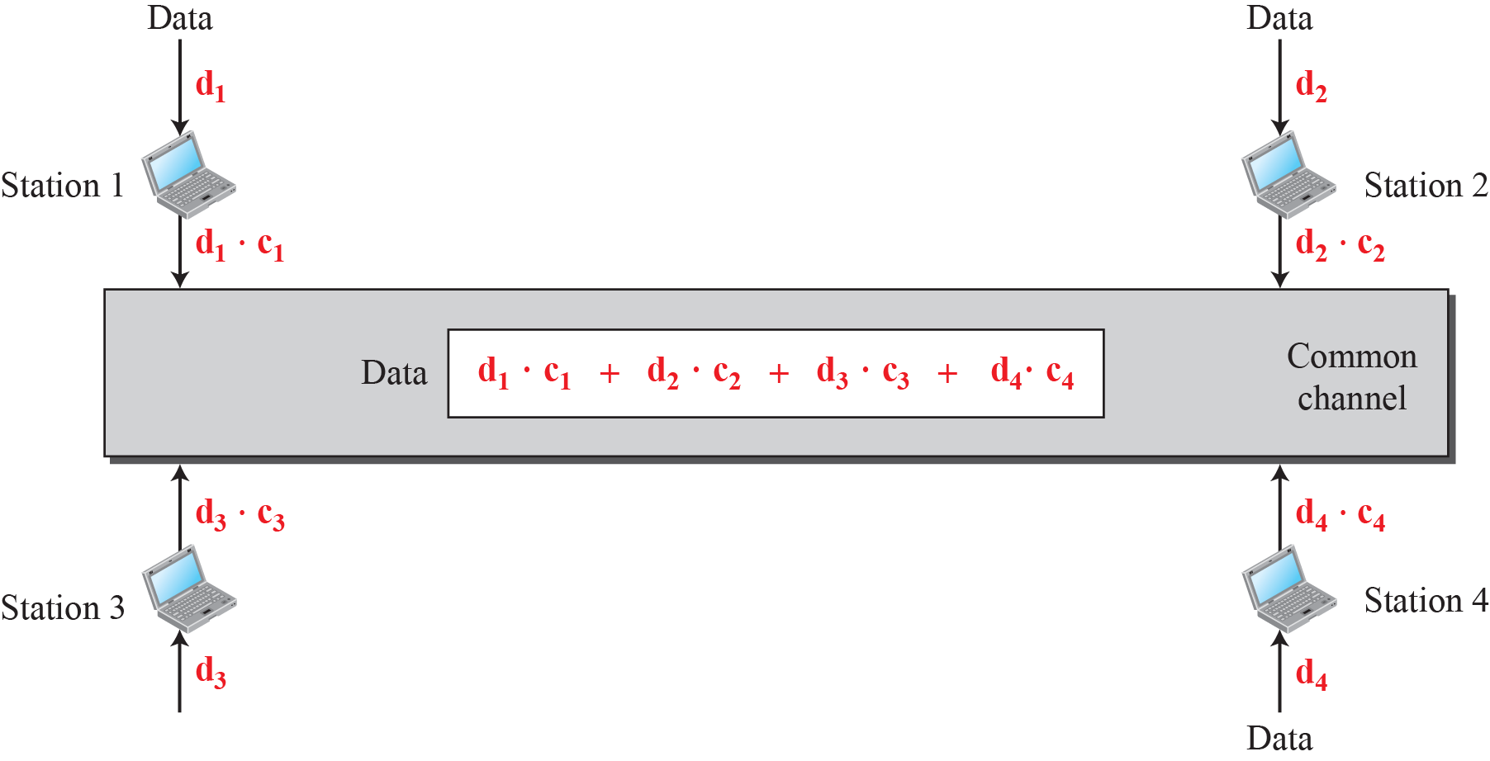
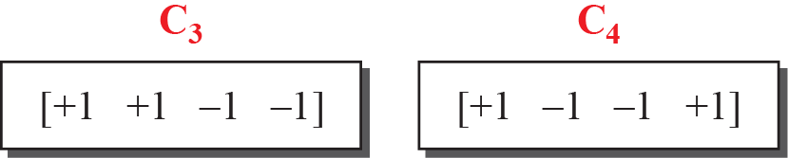
12.3.3 CDMA
Simple idea of communication with code
각 순열은 N개(Station 수)의 요소로 구성
Station 1의
Data = (d₁·c₁ + d₂·c₂ + d₃·c₃ + d₄·c₄ ) · c₁
= d₁·c₁ ·c₁ + d₂·c₂ ·c₁ + d₃·c₃ ·c₁ + d₄·c₄ ·c₁
= d₁ · 4 + d₂ · 0 + d₃ · 0 + d₄· 0
= 4 · d₁

Slide 47
12.3.3 CDMA
Chips
  CDMA is based on coding theory.
  Each station is assigned a code, which is a sequence of numbers called Chips.
Chip Sequence

Slide 48
12.3.3 CDMA
Orthogonal Sequence
  Orthogonal : 원래 수직이라는 뜻으로 사용되었으나, 후에는 곱의 합 또는 적분이 0임을 의미하는 용어
  Multiply a sequence by a number.
  2 • [+1 +1 -1 -1] = [+2 +2 -2 -2]
  If we multiply two equal sequence, we get N(number of element).
  [+1 +1 -1 -1] • [+1 +1 -1 -1] = 1+1+1+1 = 4
  If we multiply two different sequence, we get 0.
  [+1 +1 -1 -1] • [+1 +1 +1 +1] = 1+1-1-1 = 0
  Adding two sequence makes another sequence.
  [+1 +1 -1 -1] + [+1 +1 +1 +1] = [+2 +2 0 0]

Slide 49
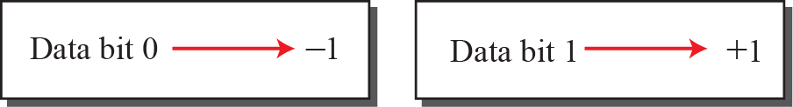
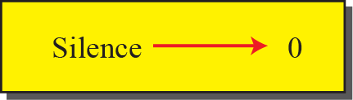
12.3.3 CDMA
Data representation in CDMA
  If a station needs to send a 0 bit, it encodes as -1.
  If a station needs to send a 1 bit, it encodes as +1.
  When a station is idle, it sends no signal, which is interpreted as bit 0.

Slide 50
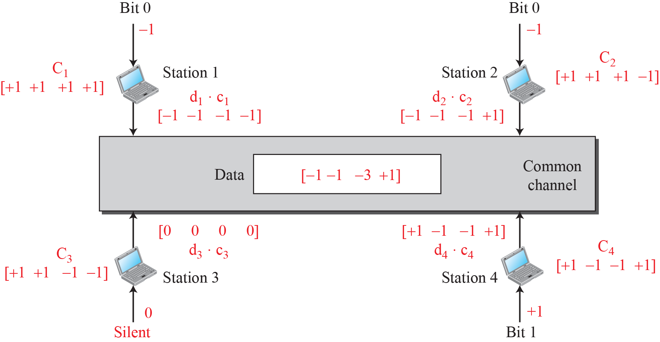
12.3.3 CDMA
Sharing Channel in CDMA
Error in Textbook
-1
+1

Slide 51
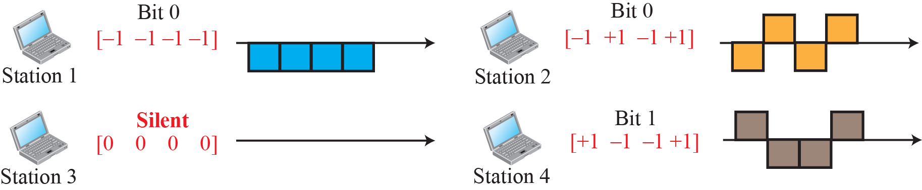
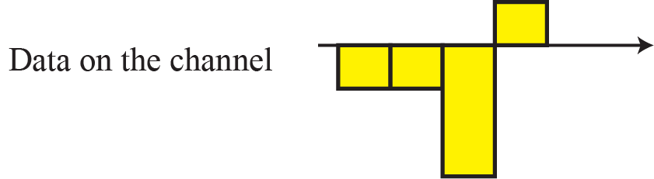
12.3.3 CDMA
Digital signal created by four stations in CDMA

Slide 52
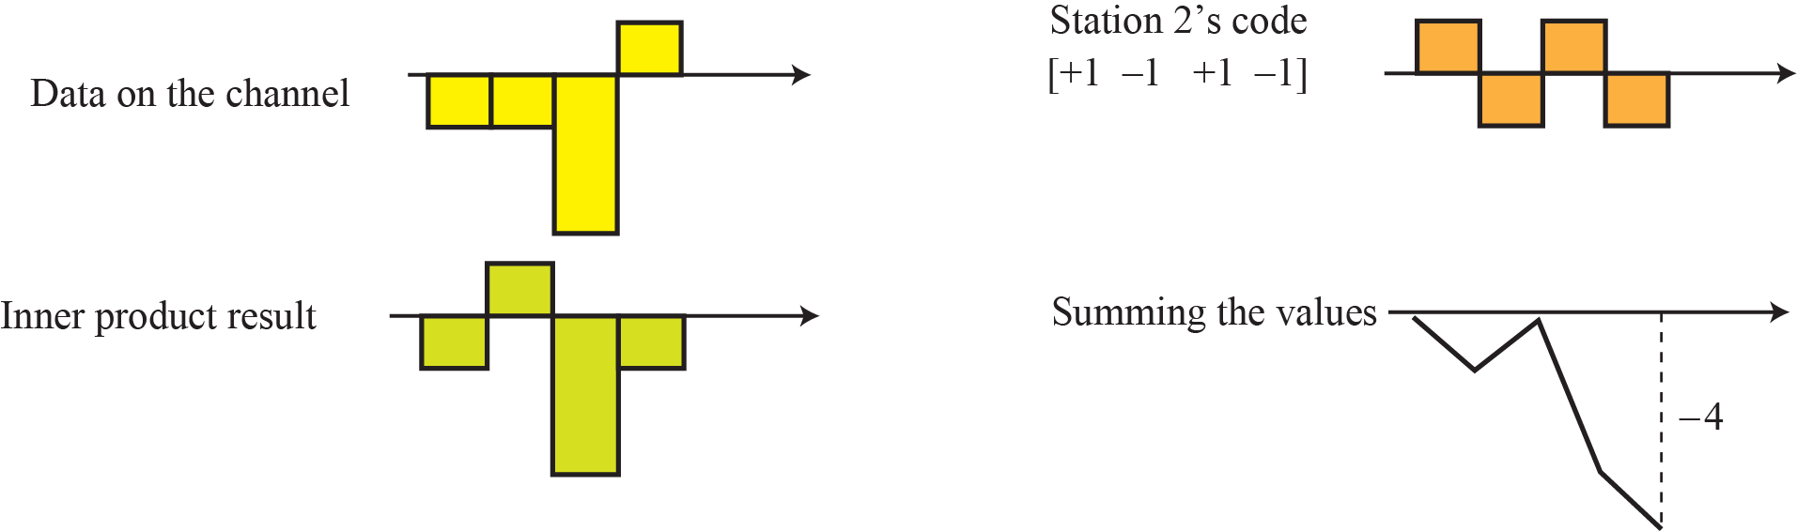
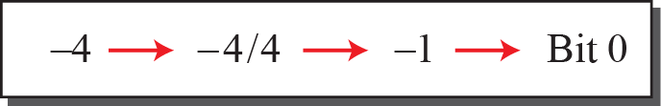
12.3.3 CDMA
Decoding of the composite signal in CDMA
  Station 3 is sensing Station 2’s signal

Slide 53
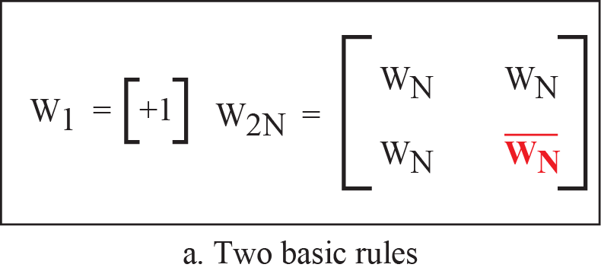
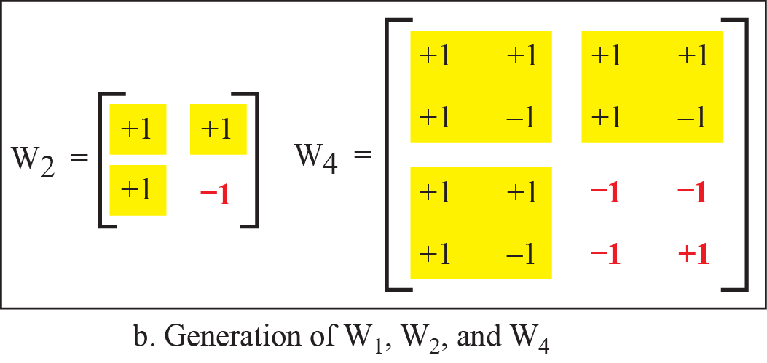
12.3.3 CDMA
Creation of Chip Sequence
  Two dimensional Walsh table
  Each row of Walsh table can be a sequence of chips.

Slide 54
12.3.3 CDMA
Find the chips for a network with 2 and 4 stations.
  For a 2 station network [+1 +1] [+1 -1]
  For a 4 station network [+1 +1 +1 +1]
  [+1 -1 +1 -1]
  [+1 +1 -1 -1]
  [+1 -1 -1 +1]

Slide 55
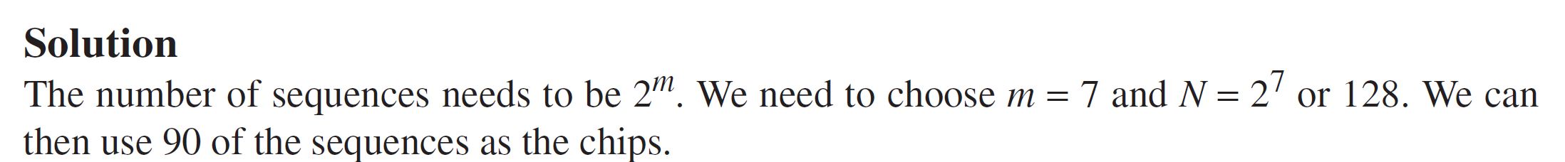
12.3.3 CDMA
What is the number of sequences if we have 90 stations in our network?

Slide 56
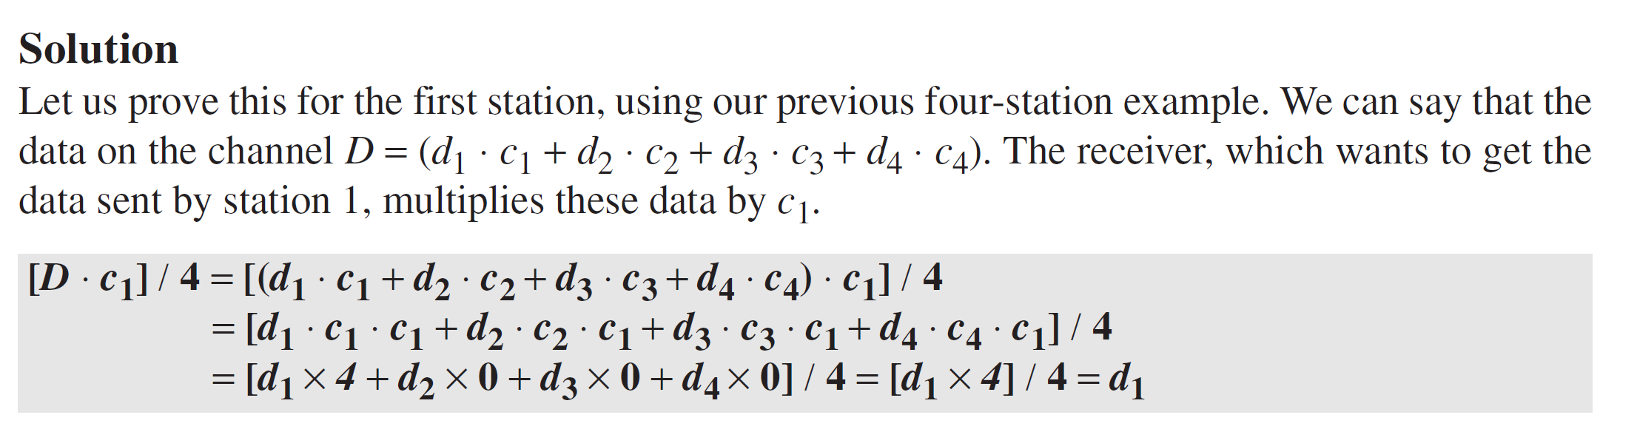
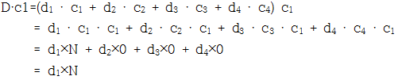
12.3.3 CDMA
A receiving station can get the data sent by a specific sender if it multiplies the entire data on the channel by the sender’s chip code and then divides it by the number of stations.

Slide 57
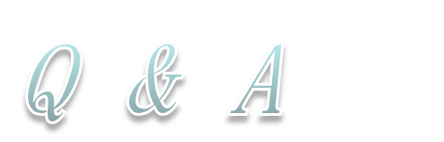
12.4 Summary
Four protocols, ALOHA, CSMA, CSMA/CD, and CSMA/CA, are described. These protocols are mostly used in LANs and WANs.
Three controlled-access protocols, reservation, polling, and token-passing, are described. Some of these protocol are used in LANs, but others have some historical value.
Three channelization protocols, FDMA, TDMA, and CDMA, are described. These protocols are used in cellular telephony, which we discuss in Chapter 16.

